Slide 1
Poverty & Fast Food
Angie, Brett, CJ, Kenn

Slide 2


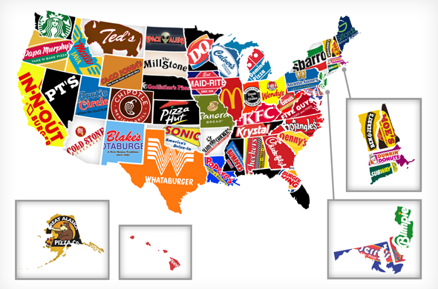

What We Are Looking For
Number of restaurants vs. poverty level
Why understanding this is important
What we can learn from the data, no matter the outcome
This Photo by Unknown Author is licensed under CC BY-NC-ND

Slide 3

What We Did
API
MongoDB
Leaflet plugin w/ sidebar
Scrapped Data
This Photo by Unknown Author is licensed under CC BY-SA-NC

Slide 4
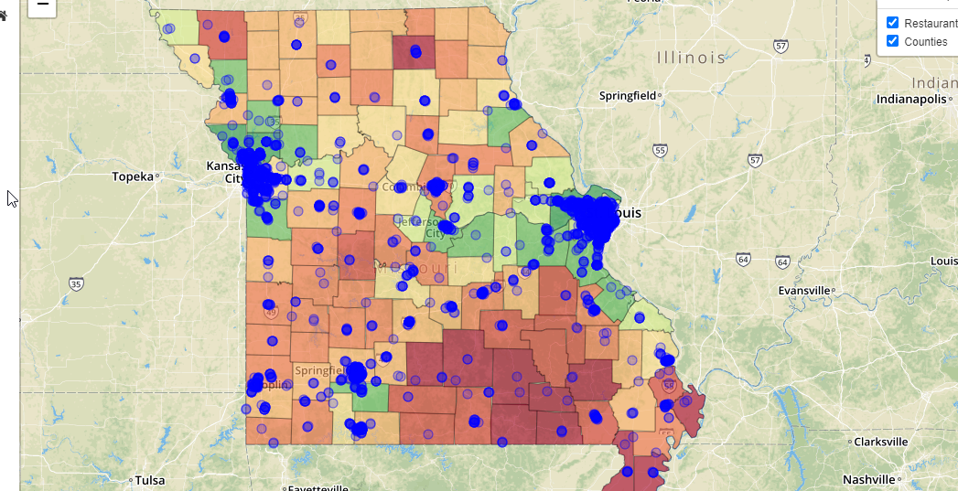
The Site
Angie and Brett, can you put in some bullet points here that you would want to see on the screen?
What do you think about the image in the background? I put it there as kind of a preview and if you did not want to say anything about it, you do not have to. We can just pretend it is nothing to talk about and then see if Matt or anyone notices that this is an image of the site. What do you all think?

Slide 5
References
Hey guys, what other sites do I need to add here?
1. Rhone, A. (2017, December 4). ERS's Updated Food Environment Atlas Shows an Increase in Fast Food Restaurants Between 2009 and 2014. Retrieved May 27, 2020, from http://www.ers.usda.gov/amber-waves/2017/december/ers-s-updated-food-environment-atlas-shows-an-increase-in-fast-food-restaurants-between-2009-and-2014/
2. 1 in 7 Americans Lived in Poverty in 2009 ... - PBS NewsHour. (2010, September 16). Retrieved May 28, 2020, from https://www.pbs.org/newshour/economy/poverty-uninsured-rates-rise-as-recession-continues
3. DeNavas-Walt, C., & Proctor, B. D. (2018, July 25). Income and Poverty in the United States: 2014. Retrieved May 27, 2020, from https://www.census.gov/library/publications/2015/demo/p60-252.html

